Slide 1


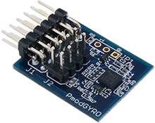
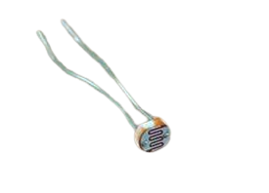
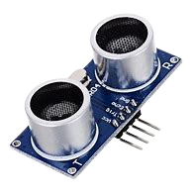
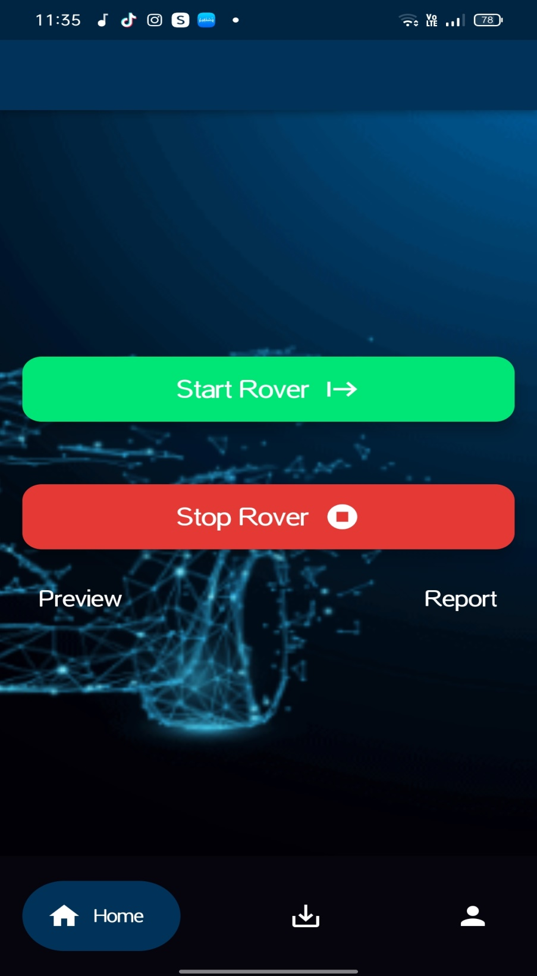
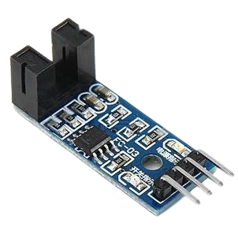
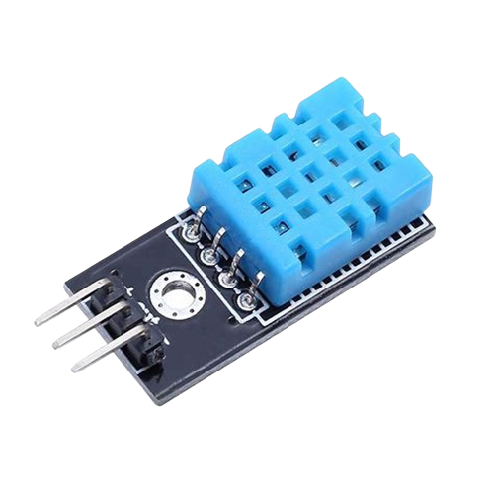
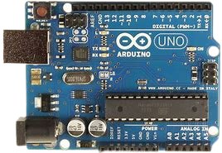
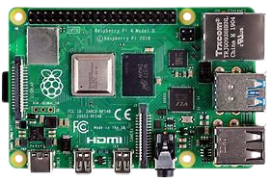


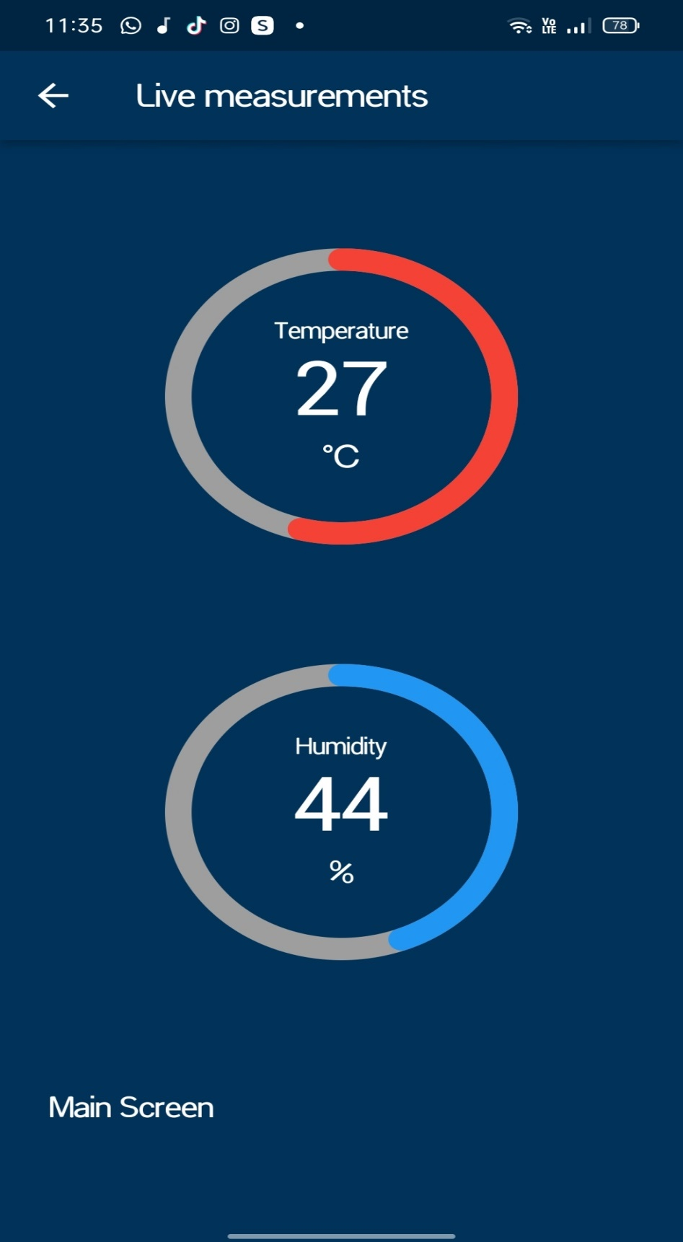

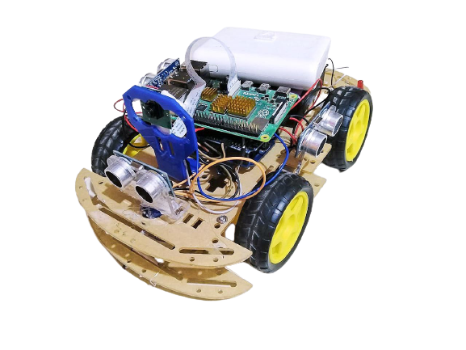
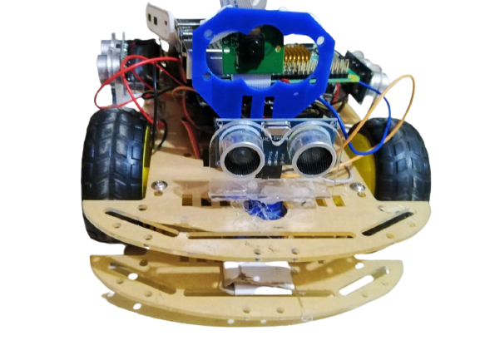

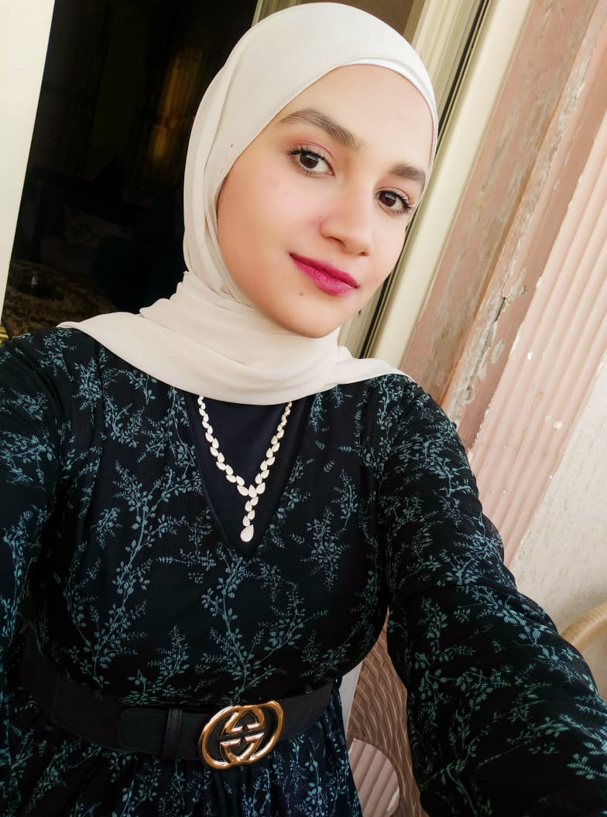
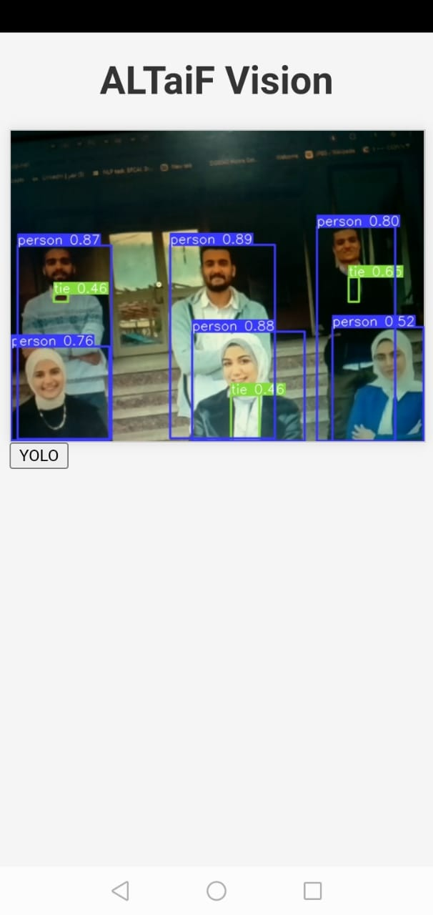
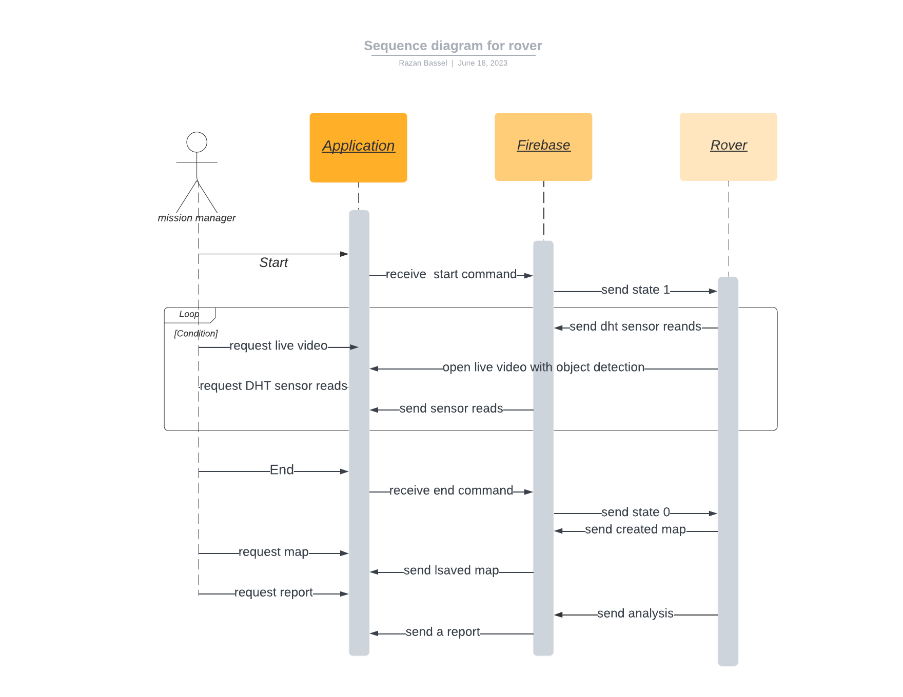
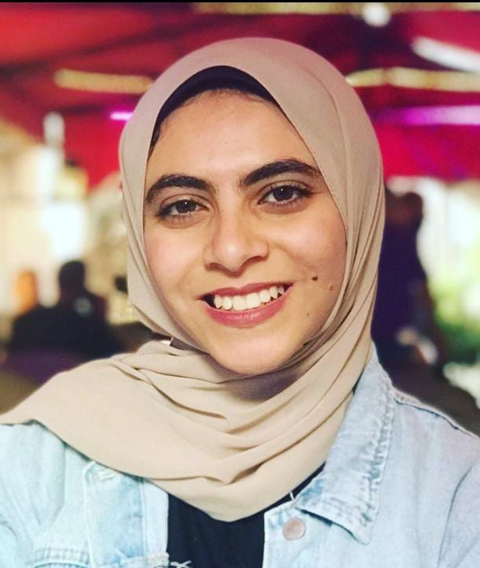
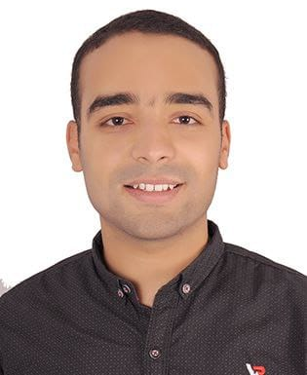
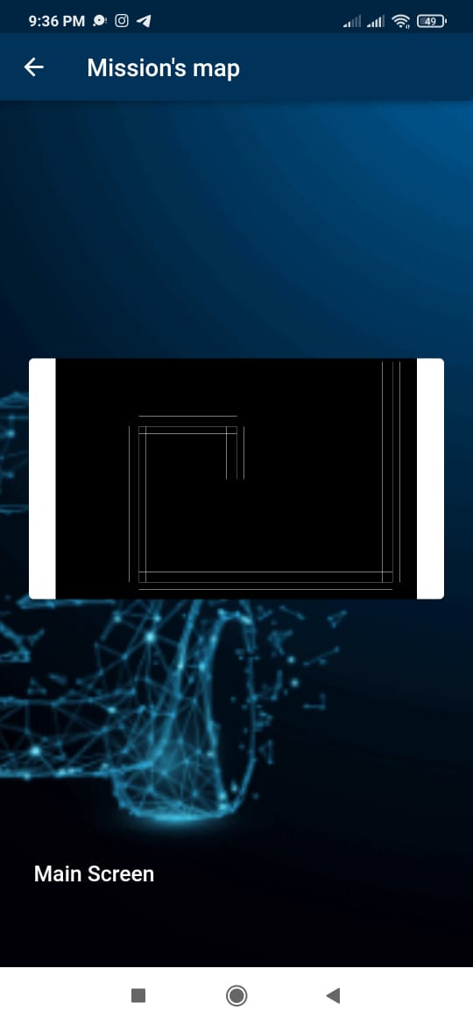
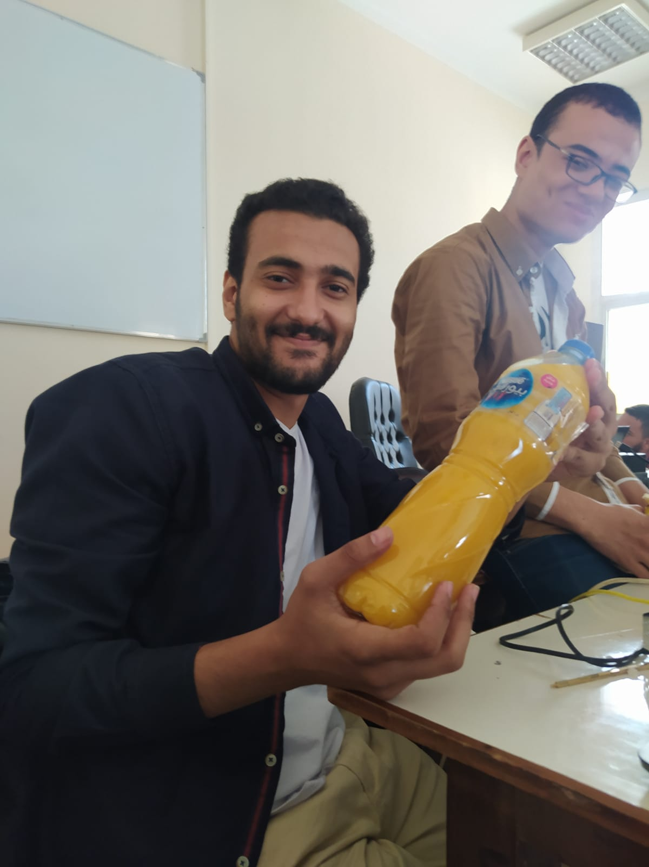
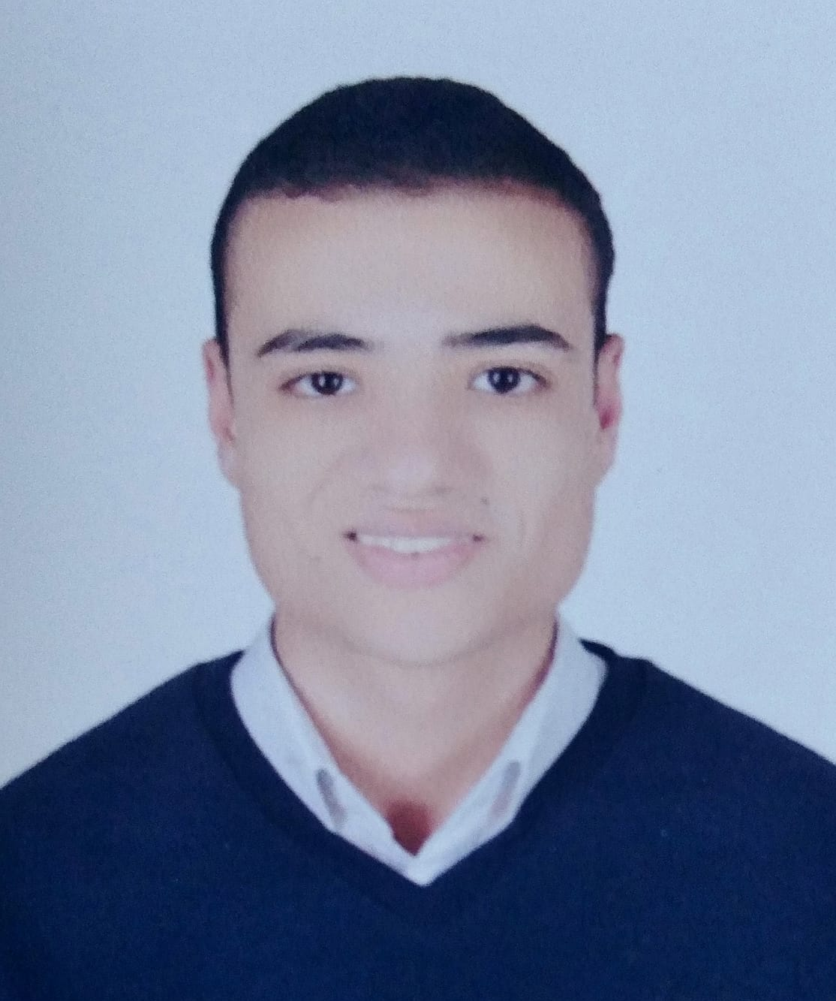
“ALTAIF ROVER”
Mohamed Khaled - Razan Bassel - Farah Mohamed - Dina Mohamed - Mohammed Said - Mohamed Hassan
Faculty of Computers & Artificial Intelligence
Dr. Mahmoud Abd Alaal
Benha University
Abstract
Materials and Methods
Results
Conclusion
Our objective is to provide a solution to reduce the time and the efforts of scientists and researchers to explore danger or narrow places. Our idea is creating a small smart explorer rover called Altaif rover that able to collect useful information about the environment which it is put in. This rover includes sensor like three ultrasonic sensors to avoid crashing with obstacles, temperature and humidity sensor, light sensor to detect day and night and speed sensor, includes four DC motors to rotate wheels and servo motor to rotate a pi camera, rover includes a pi camera with object detection model YOLO V5 to see and know what around the rover in the environment and let the researchers see a live video for what a rover sees. Our rover can provide a map of the paths it passed through in it’s mission. All this information including temperature and humidity measures and mission map will be sent to the user through a firebase to a flutter application and a live video with object detection model will be appeared on a flutter application through python and rover IP. We aim to provide a solution for hard researches by combining IOT technologies with artificial intelligence.
Servo motor
DC motors
Speed sensor
Leds
Gyroscope sensor
Light sensor
Ultrasonic
Dht11 sensor
Arduino uno
Driver
Four wheels
batteries
Raspberry pi 4 model 8G Ram
Pi camera
YOLO V5
Flutter
Firebase
Python
Flask
Arduino IDE
The user can make our rover start by clicking on start button on the application.
The rover will make some movements an take actions to avoid obstacles, ultrasonic sensor will change it’s direction if the rover is near to an obstacle to avoid crashing. And the camera will detect and send what it sees to the flutter application through a live video. A DHT11 sensor will send a temperature and humidity reads to the application with it’s changes to the flutter application so we can know if this environment is hot or cool, rainy or dry.
The rover uses ultrasonic and speed sensor to measure distances between it and any obstacle and know where it turns right or left depending on that the map will be created and it will be sent to firebase storage. To end the mission the user click on end button and he can receive the map of the mission and an analysis report about the mission.
We make our rover to create a device with IOT and artificial intelligence technologies to be able to move and explore without any help from human, and can be benefit for researchers to gain the most information can be gained about an unknown or danger environment. If the analysis of these information tell us that his place will be safe for a human or dangerous, or you can build a new life in this environment. The mobile application was created to facilitate receiving all this information to the user without being in the same place where the rover in.
References
https://www.worldwildlife.org/threats/effects-of-climate-change#:~:text=Impacts.%20Humans%20and%20wild%20animals%20face%20new%20challenges,and%20wreak%20havoc%20on%20people%E2%80%99s%20livelihoods%20and%20communities
https://www.indeed.com/career-advice/career-development/what-is-system-analysis-and-design#:~:text=Benefits%20of%20system%20analysis%20and%20design&text=Enabling%20comprehension%20of%20complicated%20structures,the%20workload%20of%20IT%20employees
https://economictimes.indiatimes.com/definition/systems-design
https://www.indeed.com/career-advice/career-development/what-is-uml#:~:text=UML%20is%20a%20visual%20language,outcomes%20or%20errors%20in%20programs.
https://slideplayer.com/slide/8452821/
https://www.timelog.com/en/blog/project-scope
https://pjreddie.com/publications/
Objectives
This project aims to facilitate the daily research missions by managing the exploring completely using IOT and computer vision, only the user start and end the mission from the application, he can receive all information automatically through application with an easy UI. The system is more safe for a scientists than exploring by themselves in danger environment may be has a very high, very low temperature or harmful objects. Or rover is small in size so it can go in narrow places where a person cannot go in and explore what are there and send us a complete picture and paths of those places even at night it has leds will be turned on at night like Ancient cemeteries or any other places hard to reach by human like space.
Acknoledgements
We Would Like To Thank faculty of computers and artificial intelligence Benha University For Supporting Us. And thanking Dr. Mahmoud Abd Alaal for helping and supporting us to achieve our goal in this project.
Team members
Razan Bassel Dina Mohamed
Farah Mohamed Mohamed Khalid
Mohamed Hassan Mohamed Said

